Slide 1
Maltese in the digital age Developing electronic resources
Claudia Borg, Institute of Linguistics
Ray Fabri, Institute of Linguistics
Albert Gatt, Institute of Linguistics
Mike Rosner, Department of Intelligent Computer Systems

Slide 2
First things first
The resources we will describe are available online:
http://mlrs.research.um.edu.mt
To gain access to the corpus, request an account on mlrs.request@gmail.com

Slide 3
Outline
A bit of history: from MaltiLex to MLRS
MLRS server and corpus
Building the corpus
Annotating it
Using the corpus
From text to tools (and back)

Slide 4
Part 1
A bit of history

Slide 5
Part 2
The MLRS Corpus

Slide 6
MLRS
The Maltese Language Resource Server is publicly available on mlrs.research.um.edu.mt
Our long-term aim is to make this a “one stop shop” for resources related to the Maltese language:
Corpora
Experimental data
Audio recordings
Wordlists, dictionaries (including Maltese sign language)
Software tools for language processing
Current status:
A large (ca. 100 million token) corpus of Maltese is available and browsable online.
The corpus is growing...

Slide 7
What’s a corpus useful for?
A couple of example research questions:
What are the terms that characterise Maltese legal discourse, and are specific to its register?
How many noun derivations are there that end in –ar (irmonkar...) or –zjoni (prenotazzjoni...)?
What is the difference in meaning between żgħir and ċkejken?
What words rhyme with kolonna?
How many words can I find with the root k-t-b and what is their frequency?
Does the verb ikklirja tend to occur in transitive or intransitive constructions?
(We’ll come back to these later)

Slide 8
The corpus as it currently stands
Large collection of texts, collected opportunistically.
I.e. No attempt to collect data that is “balanced” or “statistically representative” of the distribution of genres in Maltese.
However, our aim is to expand each section of the corpus (each “sub-corpus”) significantly.

Slide 9
Sub-corpora
Academic text 94k
Legal text 6.1m
Literature/crit 488k
Parliamentary debates 47m
Press 32m
Speeches 18k
Web texts (blogs etc) 13m
Total >99 million tokens

Slide 10
Is that enough?
The short answer: depends on what you want to do!
Examples:
Word frequency distributions behave oddly: few giants, many midgets. The more texts we have, the more likely we are to be able to represent a larger segment of Maltese vocabulary.
Statistical NLP systems need huge amounts of texts to be trained.
The corpus is being continuously expanded. We especially want to expand on the “smaller” categories: academic, literature...

Slide 11
How the corpus is built
Original source texts
web pages
documents (text, word, pdf etc)
...

Slide 12
How the corpus is built
Original source texts
web pages
documents (text, word, pdf etc)
...
Automatic processing
Text extraction
Paragraph splitting
Sentence splitting
Tokenisation
(Linguistic annotation)

Slide 13
How the corpus is built
Original source texts
web pages
documents (text, word, pdf etc)
...
Automatic processing
Text extraction
Paragraph splitting
Sentence splitting
Tokenisation
(Linguistic annotation)
Final version
Machine-readable format (XML)

Slide 14
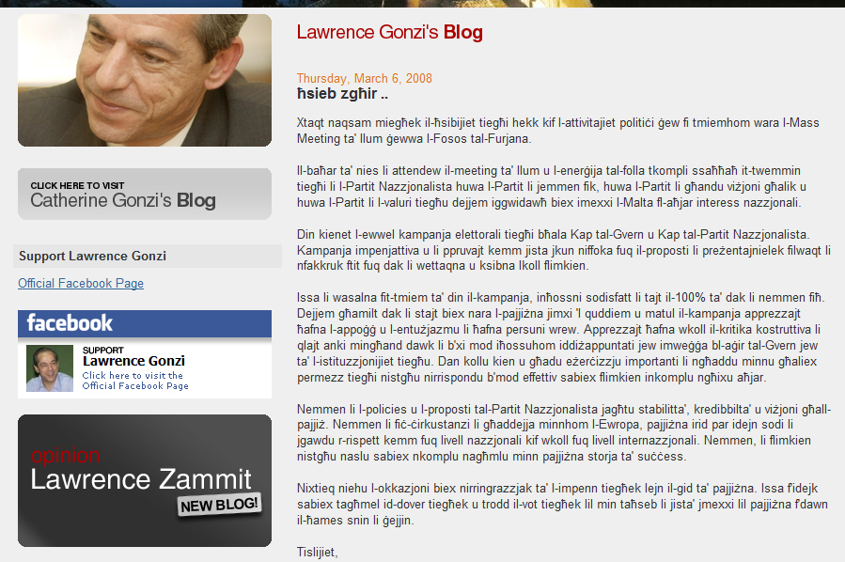
Example: text from the internet

Slide 15
Example: web pages
A completely automated pipeline.
High frequency Maltese words
Kien
Kienet
Il-
...

Slide 16
Example: web pages
A completely automated pipeline.
High frequency Maltese words
Kien
Kienet
Il-
...
Google/Yahoo search

Slide 17
Example: web pages
A completely automated pipeline.
High frequency Maltese words
Kien
Kienet
Il-
...
Google/Yahoo search
URL list

Slide 18
Example: web pages
A completely automated pipeline.
High frequency Maltese words
Kien
Kienet
Il-
...
Google/Yahoo search
URL list
Page download

Slide 19
Example: web pages
A completely automated pipeline.
High frequency Maltese words
Kien
Kienet
Il-
...
Google/Yahoo search
URL list
Text Processing
Page download

Slide 20
Processing text after download
Extract the text from the page
Using html parsers

Slide 21
Processing text after download
Extract the text from the page
Using html parsers
Identify and remove non-Maltese text
Using a statistical language identification program

Slide 22
Processing text after download
Extract the text from the page
Using html parsers
Identify and remove non-Maltese text
Using a statistical language identification program
Split it into paragraphs, sentences, tokens

Slide 23
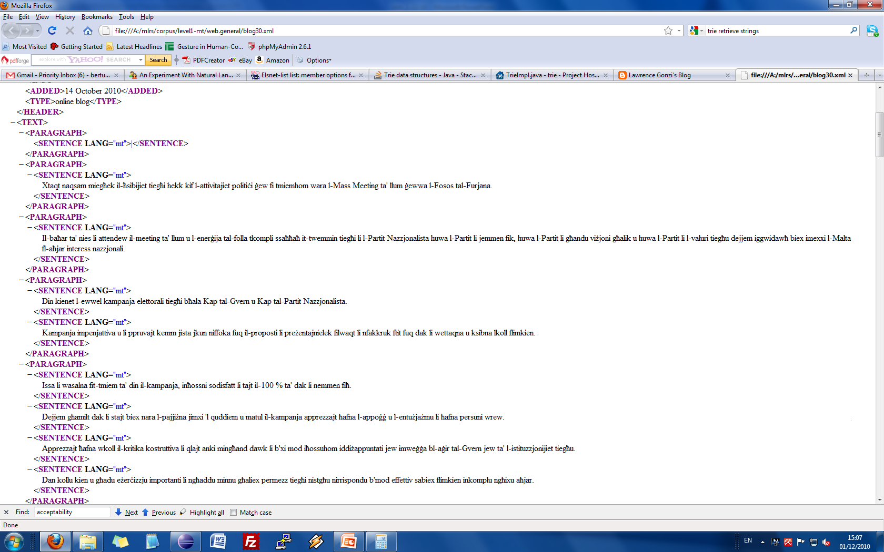
What a corpus text looks like
NB: This format is not for human consumption! It is intended for a program to be able to identify all the relevant parts of the text.

Slide 24
The point of this
We have written a large suite of programs to process texts in various ways.
We can give a uniform treatment to any document in any format.
The outcome is always an XML document with structural markup.
Every document also contains a header which describes its origin, author etc.
This makes it very easy to expand the corpus.

Slide 25
Part 3
Using the corpus

Slide 26
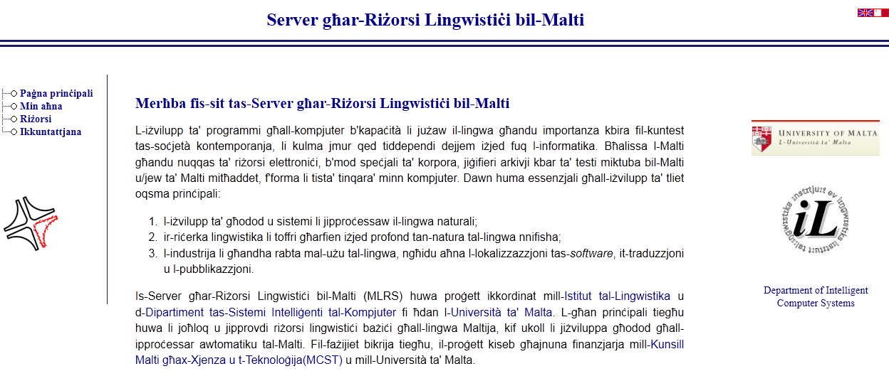
http://mlrs.research.um.edu.mt
The MLRS server contains a link to the corpus (among other resources).
The corpus is accessible via a user-friendly interface.

Slide 27
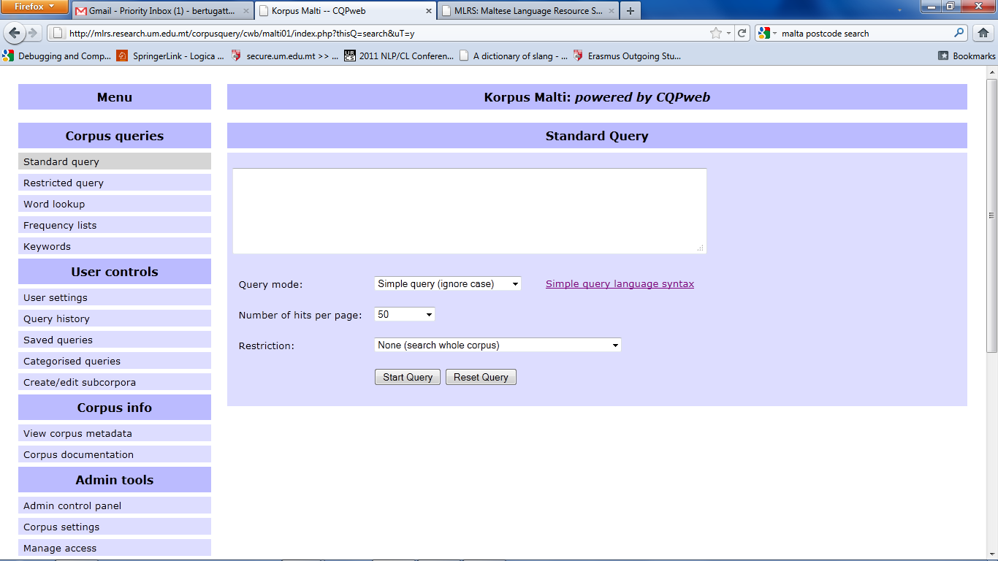
The corpus interface

Slide 28
The corpus interface
Search for words or phrases

Slide 29
The corpus interface
Look up words matching specific patterns

Slide 30
The corpus interface
Construct frequency lists

Slide 31
The corpus interface
Identify significant keywords

Slide 32
Query and searching
The interface allows a user to:
Conduct searches for specific words/phrases, or patterns.
Compare a subcorpus to the whole corpus to identify keywords using statistical techniques
Compute collocations (significant co-occurring words)
Annotate search results for later analysis.
Full documentation on how to use the corpus interface will be available in the coming weeks.

Slide 33
Back to our initial examples
A couple of example research questions:
What are the terms that characterise Maltese legal discourse, and are specific to its register?
How many noun derivations are there that end in –ar (irmonkar...) or –zjoni (prenotazzjoni...)?
What is the difference in meaning between żgħir and ċkejken?
What words rhyme with kolonna?
How many words can I find with the root k-t-b and what is their frequency?
Does the verb ikklirja tend to occur in transitive or intransitive constructions?
(We’ll come back to these later)

Slide 34
Part 4
From text to tools and back

Slide 35
Tool 1: Adding linguistic annotation
The corpus texts are currently marked up only structurally.
No linguistic annotation:
Impossible to search for all examples of din occurring as a noun (rather than a demonstrative).
Impossible to identify all verbs that match the pattern k-t-b
...

Slide 36
Tool 1: Part of Speech Tagging
Sentence
Peppi kien il-Prim Ministru.

Slide 37
Tool 1: Part of Speech Tagging
Sentence
Peppi kien il-Prim Ministru.
Tokenisation
[Peppi, kien, il-, Prim, Ministru, .]

Slide 38
Tool 1: Part of Speech Tagging
Sentence
Peppi kien il-Prim Ministru.
Tokenisation
[Peppi, kien, il-, Prim, Ministru, .]
Categorisation
Peppi → NP
kien → VA3SMR
Il- → DDC
...

Slide 39
Tool 1: Part of Speech Tagging
We have developed a Part of Speech Tagger, which automatically categorises words according to their morpho-syntactic properties.
Sentence
Peppi kien il-Prim Ministru.
Tagger
Pre-trained based on manually tagged text
POS Tagset
Lists the relevant morphosyntactic categories of Maltese

Slide 40
Tool 1: How does it work?
We manually tag a number of texts.

Slide 41
Tool 1: How does it work?
We manually tag a number of texts.
We then train a statistical language model which takes into account:
The “shape” of a word:
E.g. What is the likelihood that a word ending in –zjoni will be a feminine common noun?
The context:
If the previous word was tagged as an article, what is the likelihood that the word din will be tagged as a noun?

Slide 42
Tool 1: Current performance
Tagger has an accuracy of 85-6%.
Not enough!
We now have some funds to recruit people to help us train it better (more manual tagging, correction of output).
Note: in order to develop a POS Tagger, you need a corpus in the first place!

Slide 43
Tool 2: spell checking
Corpora can also help in developing sophisticated spelling correction algorithms.
We are currently developing two spell checkers, which we intend to make available publicly.
This is work in progress

Slide 44
Tool 2: The simplest version
Word: ħafan

Slide 45
Tool 2: The simplest version
Dizzjunarju
arpa
arpeġġ
astjena
...
Bertu
...
ħafen
ħafna
...
Word: ħafan

Slide 46
Tool 2: The simplest version
Dizzjunarju
arpa
arpeġġ
astjena
...
Bertu
...
ħafen
ħafna
...
ħafen
(one substitution)
Word: ħafan
ħafna
(transposition)

Slide 47
Tool 2: The simplest version
Dizzjunarju
arpa
arpeġġ
astjena
...
Bertu
...
ħafen
ħafna
...
ħafen
(one substitution)
Word: ħafan
ħafna
(transposition)
The speller identifes the dictionary alternatives which are “closest” to the user’s entry, by calculating the cost of transforming the user’s word into another word.
User is offered the “nearest” candidates.

Slide 48
Tool 2: A slight variation
Dizzjunarju
arpa
arpeġġ
astjena
...
Bertu
...
ħafen
ħafna
...
ħafen
(one substitution)
Frequency: 3
Word: ħafan
ħafna
(transposition)
Frequency: 250

Slide 49
Tool 2: A slight variation
Dizzjunarju
arpa
arpeġġ
astjena
...
Bertu
...
ħafen
ħafna
...
ħafen
(one substitution)
Frequency: 3
Word: ħafan
ħafna
(transposition)
Frequency: 250
We can exploit the corpus to identify word frequencies, and then propose the most frequent candidates to the user.

Slide 50
Tool 2: A much more interesting variation
Many errors are not actually typos!
Għalef li ma kellux ħtija
A dictionary-based speller without context is useless here!

Slide 51
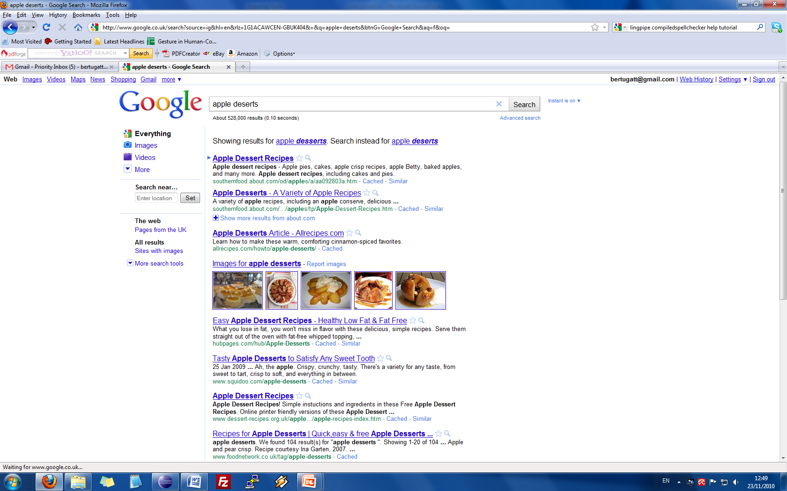
Here’s a really cool application

Slide 52
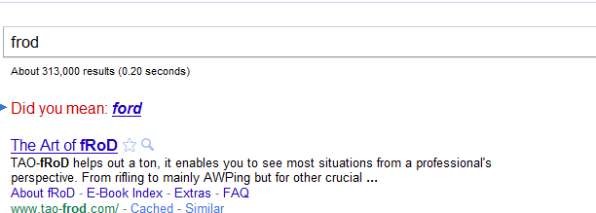
Even real mistakes depend on context

Slide 53
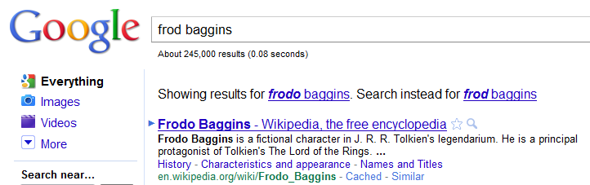
Even real mistakes depend on context

Slide 54
How this works
These spellers use a statistical model of language:
Models the probability of sequences of characters.
Language is modeled as a sequence of transitions between characters, with associated probabilities.
g → ħ → a → l → e → f → _ → l → i

Slide 55
How this works
These spellers use a statistical model of language:
Models the probability of sequences of characters.
Language is modeled as a sequence of transitions between characters, with associated probabilities.
g → ħ → a → l → e → f → _ → l → i
The sequence ħalef li is much more likely than the sequence għalef li

Slide 56
How this model is built
Once again, our starting point is a corpus!
We build the model based on several million sentences.
A few real examples:
Peppi għalef in-nagħaġ: 0.00...219
Peppi ħalef in-nagħaġ: 0.000...156

Slide 57
How this model is built
Once again, our starting point is a corpus!
We build the model based on several million sentences.
A few real examples:
Peppi għalef in-nagħaġ: 0.00...219
Peppi ħalef in-nagħaġ: 0.000...156
NB: None of these sentences was actually in our corpus. The statistical model can generalise to some extent!

Slide 58
So what we’re trying to do is...
Dizzjunarju
ħafen
ħafna
...
ħafen
Low probability in this context
Sentence:
Xtara ħafan ħut
ħafna
High probability in this context
Statistical language model
Apart from using distance, we are also exploiting context. Once again, this is only possible if we have a large corpus.

Slide 59
A slight problem
The corpus actually contains typos!
This means we can’t build proper spelling correction algorithms until we’ve corrected the typos in the training data.
Our next goal is to actually correct all the errors in the corpus.

Slide 60
Tool 3: Morphological analysis and generation
Computational analysis of the formation of words
Currently, focusing on grouping together related words automatically, on the basis of orthography
Eventually we will also use phonetic transcription
This is work in progress

Slide 61
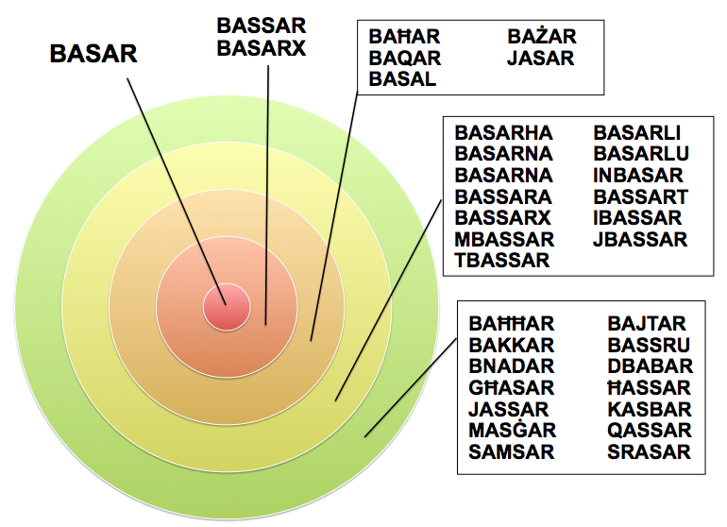
Tool 3: Morphological analysis and generation
Minimum Edit Distance

Slide 62
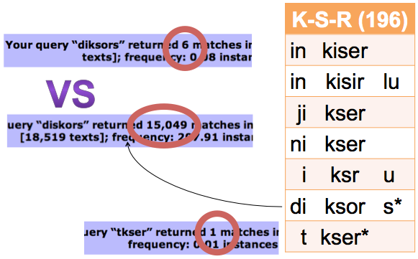
Tool 3: Morphological analysis and generation
Clustering based on patterns, e.g. K-S-R

Slide 63
Part 5
Some conclusions

Slide 64
Main conclusions
A corpus is essential for linguistic research:
It allows us to identify relevant data and quantify it.

Slide 65
Main conclusions
A corpus is essential for linguistic research:
It allows us to identify relevant data and quantify it.
It is also essential for building better tools for automatic language processing.

Slide 66
Main conclusions
A corpus is essential for linguistic research:
It allows us to identify relevant data and quantify it.
It is also essential for building better tools for automatic language processing.
Our corpus is far from “final”. What we have presented is work in progress. But it is already available and can be used.

Slide 67
Join us!
Go to mlrs.research.um.edu.mt
Send a request to mlrs.request@gmail.com to create a user account.
Contribute!
We are going to create an online facility for people to contribute texts.
We are interested in Maltese texts of any kind
Email
Blog
Literature
Academic work (including student theses, assignments...)
We will shortly be announcing this. Help us make this a better resource.

Slide 68
Researchers have nothing to lose but their intuitions.
Linguists of all persuasions unite!

